Slide 1
Digital Financial Services in Africa and Ghana
Trends, Impact & Regulatory Insights
Daniel Adjei-Nyarko
FinTech and Innovation Office, Bank of Ghana
16 April 2025

Slide 2
Digital Financial Service?????
- Financial services via digital platforms
- Includes mobile money, digital banking, insurtech, lending, etc.
Role in promoting financial inclusion

Slide 3
Yes, Regulators Have an Interest in Your Success!
Digital Financial
Service
‹#›

Slide 4
The Rise of DFS in Africa
- Mobile and internet penetration
- 600M+ mobile money accounts (GSMA, 2023)
- DFS empowering underserved populations
- Key actors: Telcos, Fintechs, Banks, Regulators

Slide 5
Key Trends in DFS Across Africa
- Mobile money dominance
- Growth in digital lending, insurance
- Cross-border DFS
- Regulatory innovation: sandboxes, instant payments

Slide 6
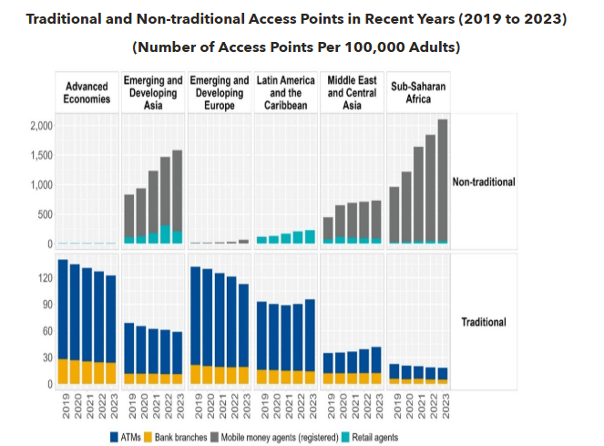
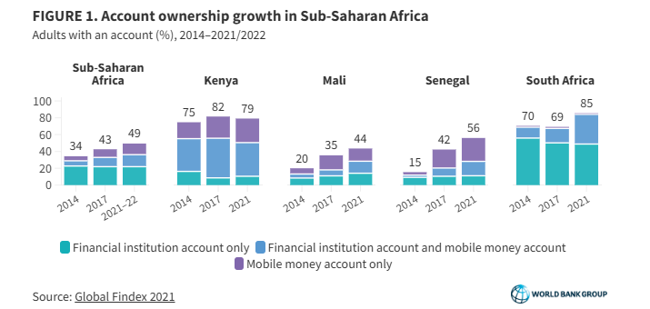
The Undeniable Impact of DFS
‹#›
‹#›

Slide 7
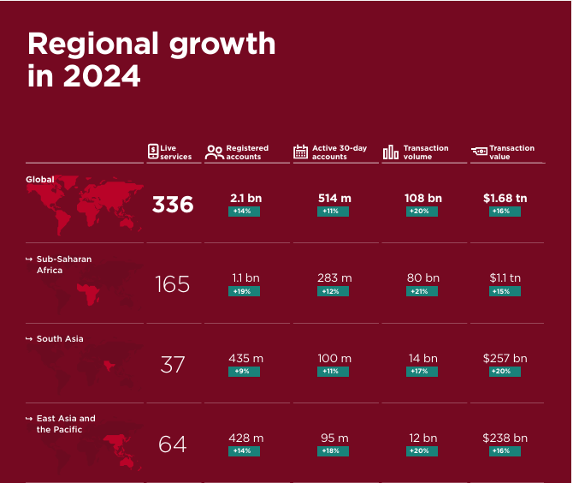
Mobile Money Summary Report 2024 - GSMA
Source: Mobile Money Summary Report 2024 GSMA

Slide 8
DFS Ecosystem in Ghana
- 59 licensed Payment Service Providers
- Collaboration among BoG, telcos, banks
- 130%+ mobile subscription
- >50% adults use mobile money
- GhIPSS enables interoperability

Slide 9
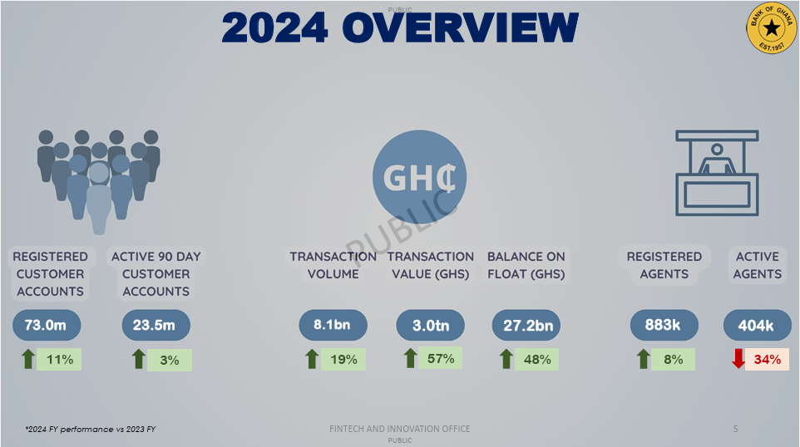

Slide 10
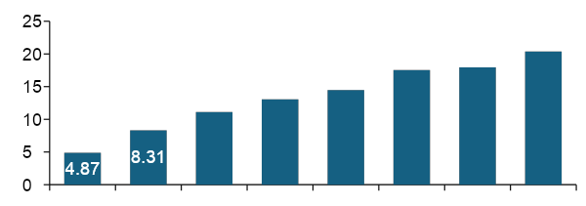
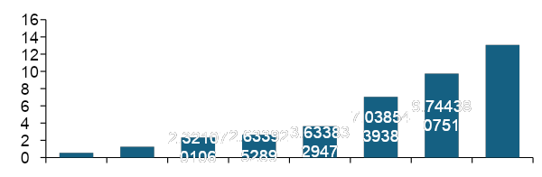
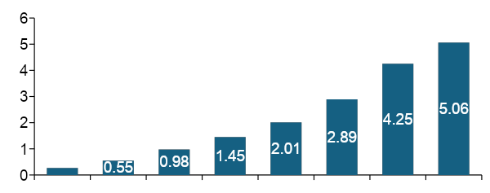
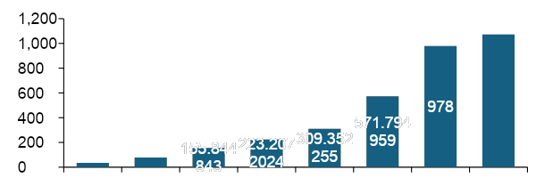
Ghana Mobile Money Statistics: YoY
+13.6%
+10.7%
+2.4%
+34.1%
+17.4%
+21.2%
+38.4%
+33.8%
+13.5%
+93.7%
Millions
+70.6%
+84.6%
20.38
Billions - GHS
+38.0%
13.07
13.06
14.46
17.53
17.95
+129.5%
11.12
0.55
1.26
2015
2016
2017
2018
2019
2020
2021
2022
2015
2016
2017
2018
2019
2020
2021
2022
Active e-money accounts
Float Balance
+19.1%
+9.6%
+38.6%
+47.1%
+71.0%
+48.0%
+43.8%
+43.2%
+84.8%
Billions
+78.2%
Billions - GHS
+98.5%
+38.6%
1,072
+103.7%
+121.5%
0.27
35
79
2015
2016
2017
2018
2019
2020
2021
2022
2015
2016
2017
2018
2019
2020
2021
2022

Slide 11
Dynamics in the FinTech Space

Slide 12
Areas Being Disrupted by FinTechs in Ghana
Lending
Mobile Payments
Cross Border Remittance
DeFi
Acquiring
Payment Processing
Savings & Investment
Insurance
Pensions

Slide 13





Some Key Enablers

Slide 14






Consumer Expectations
‹#›

Slide 15
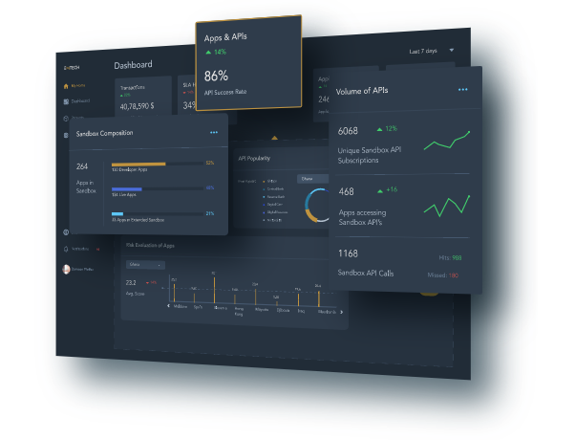
Regulatory Sandbox
Accelerate time to Market Reduced time to Market for FinTechs | Cost Savings Reduce the cost of innovation for Innovators | Regulator & Policy Environment Multi-stakeholder regulatory environment to evaluate emerging financial technologies and development of regulatory frameworks and policies for such entities
Digital Sandbox Use the Sandbox as a medium of updating current regulatory Policies | Improve Engagement & Innovation As a tool to encourage new Innovators to formalize their businesses and encourage incumbent innovators to experiment with new ideas | Visibility on Emerging Technologies Serve as a platform for regulators to learn about emerging technologies that are fast disrupting the financial sector

Slide 16
Thank You

